Slide 1

CREDIT CARD APPROVAL
July 2021
Project By: Daniel Premisler, Oz Abukan, Maria Gross

Slide 2
Agenda
Motivation and Data description
Who is a “bad” customer
EDA & Feature engineering
Classification metric selection
Comparing best model to baseline models
Conclusion and discussion

Slide 3
Motivation - back story
One of the common issues in the banking industry is predicting the probability of future defaults.
Credit risk assessment is a common risk control method to deal with this issue.
The bank uses the risk assessment to determine whether to issue a credit card to an applicant.

Slide 4
Motivation - back story
Creating a ML model to predict if a customer is considered a “risky” customer is a matter of great importance.
Finding a good ML model to predict “bad” and “good” customers, increases the chance of preventing a huge loss / gaining a significantly higher profit.

Slide 5
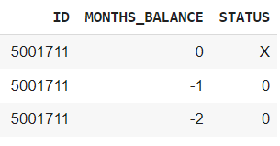
Data description
Real life data:
Type | # features | Row size | description | Feature examples
Application_record.csv | 18 | 500k + | Personal info | Account Id, gender, income, age, occupation, employment status, family size, etc.
Credit_record.csv | 3 | 1m + | Credit record | Account Id, month, status of payment past due date

Slide 6
Who is a “bad” customer?
The Issue:
The class labels: “good” or “bad” are not given in our dataset
New task - define the labels: “good” and “bad” by ourselves!
The Solution:
In order to define the labels, we had to come up with business logic
The logic is based on checking the maximum period for which a customer was late with the loan payment.
The result: we end up with 6 different scenarios, each one representing a different definition of a “bad” customer
For example:
y_1 - “bad” = customer which pay due was 1+ days
y_2 - “bad” = customer which pay due was 1+ months

Slide 7
Who is a “bad” customer - continue
status | description | %
c, x | Paid off loan or no loan | 5.6%
0 | Up to 1 month past due | 69.6%
1 | 2 months past due | 20.1%
2 | 3 months past due | 2.3%
3 | 4 months past due | 0.6%
4 | 5 months past due | 0.2%
5 | 6+ months past due | 1.3%
Scenario | “Bad” customer | “Good” customer
Y 1 | [0, 1, 2, 3, 4, 5] | [c, x]
Y 2 | [1, 2, 3, 4, 5] | [c, x, 0]
Y 3 | [2, 3, 4, 5] | [c, x, 0, 1]
Y 4 | [3, 4, 5] | [c, x, 0, 1, 2]
Y 5 | [4, 5] | [c, x, 0, 1, 2, 3]
Y 6 | [5] | [c, x, 0, 1, 2, 3, 4]

Slide 8
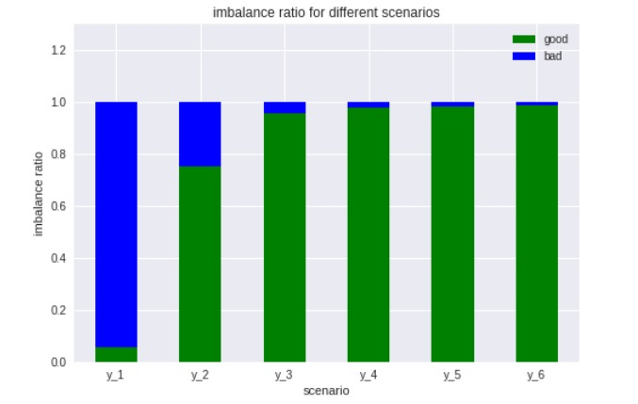
Different y scenarios
In the first scenario most of our cases are “bad” customers in the rest of the scenarios we have fewer “bad” customer
All the scenarios have imbalanced classes, in y3 - y6 the distribution of class is similar, we would analyze the cases with different class distribution (y1, y2, y3)
1
2

Slide 9
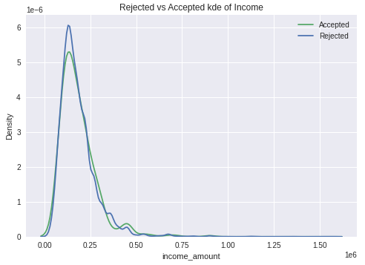
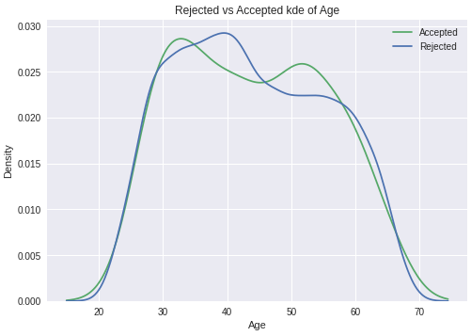
EDA & Feature engineering
Based on y_3 scenario

Slide 10
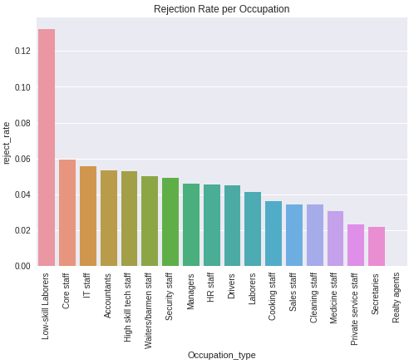
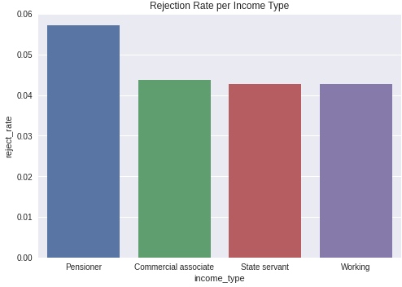
EDA & Feature engineering
Based on y_3 scenario

Slide 11
Data Preprocessing
Missing Values
add missing indicator and a missing category to occupation
Adding features
Add features: Age, years employed, employed_stat
Reassembly
Rare label encoding, of rare categories 1% or less frequency
Dummies
One Hot Encoding
Outliers and distribution
Handling Outliers and distribution with discretization
Scaling
Feature scaling (none dummies)

Slide 12
Classification metric selection
Selecting the best metric for the model is dependent on the errors we want to minimize which are:
False negative errors (Type I) : giving a loan to a “bad” customer
False positive errors (Type II) : not giving a loan to a “good” customer
Making a type I error would be more costly to a bank than a Type II error
Since we want to maximize revenue we would like to minimize the Type I error and some Type II error if possible

Slide 13
Metrics reasoning
Metric | reasoning | Why it didn't work for us
Recall of “bad” customer | Minimize Type I error | ML models classified all cases as “bad” customer a better accuracy is needed
F1 of “bad” customer | Get balanced results of both precision and recall | We still want to focus much more on recall than precision
Accuracy | Minimizes Both errors | Data is imbalanced accuracy doesn't work as a good metric in our case
90% recall + 10% precision (Final metric of choice) | Minimizes Type I error preventing from the model to classify all of the cases as “bad” customers

Slide 14
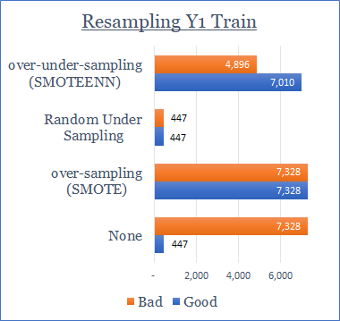
Baseline model - y1 results
Resampling method | Mean | Mean difference with respect to ‘None’ | STD
None | 99.16% | - | 0.09%
SMOTE (Over Sampling) | 97.07% | -2.09% | 0.42%
Random Under Sampling (Under Sampling) | 56.87% | -42.29% | 1.97%
SMOTEENN (Over and Under Sampling) | 93.13% | -6.03% | 0.37%
Baseline model: RandomForest

Slide 15
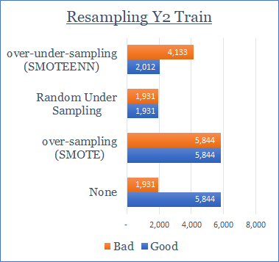
Baseline model - y2 results
Resampling method | Mean | Mean difference with respect to ‘None’ | STD
None | 6.49% | - | 1.17%
SMOTE (Over Sampling) | 16.91% | +10.42% | 1.27%
Random Under Sampling (Under Sampling) | 49.44% | +42.95% | 1.67%
SMOTEENN (Over and Under Sampling) | 53.34% | +46.85% | 1.30%
Baseline model: RandomForest

Slide 16
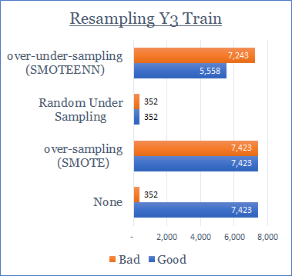
Baseline model - y3 results
Resampling method | Mean | Mean difference with respect to ‘None’ | STD
None | 9.11% | - | 2.34%
SMOTE (Over Sampling) | 9.45% | +0.34% | 2.21%
Random Under Sampling (Under Sampling) | 49.01% | +39.90% | 4.82%
SMOTEENN (Over and Under Sampling) | 11.41% | +2.30% | 2.57%
Baseline model: RandomForest

Slide 17
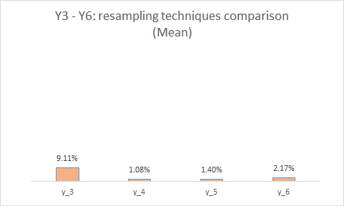
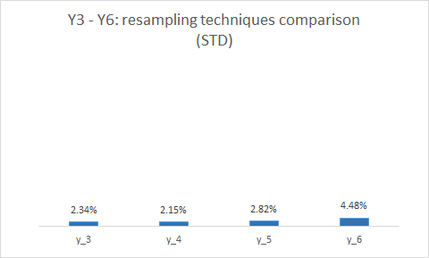
Y3 to Y6 - resampling techniques comparison
No Resampling
Baseline model: RandomForest

Slide 18
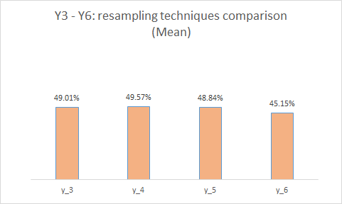
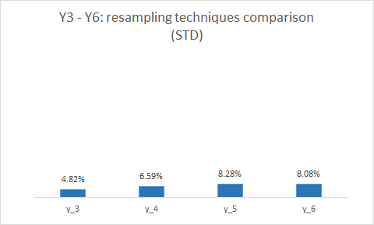
Y3 to Y6 - resampling techniques comparison
Random Under Sampling
Baseline model: RandomForest

Slide 19
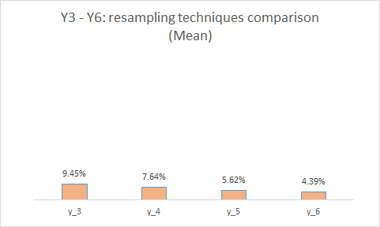
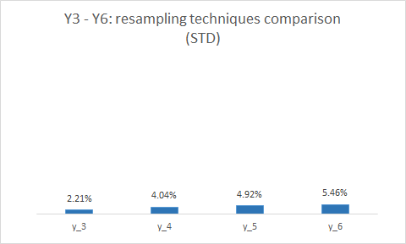
Y3 to Y6 - resampling techniques comparison
SMOTE
Baseline model: RandomForest

Slide 20
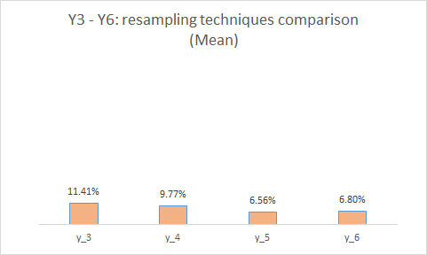
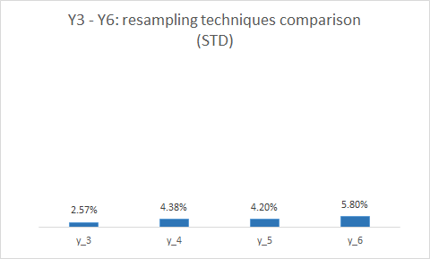
Y3 to Y6 - resampling techniques comparison
SMOTEEN
The results of all 4 y’s are similar, for this reason we analyze only y3 of the y’s and omit the others
Baseline model: RandomForest

Slide 21
Auto ML
Our goal is to find a solution space with respect to the dimensions involved:
Y’s - 6 different class labels (y1, y2, y3, y4, y5, y6)
Imbalance methods - 4 resampling method
None
Over Sampling
Under Sampling
Over and Under Sampling)
Evaluation metrics - 4 metrics:
Recall of “bad” customer
F1 of “bad” customer
Accuracy
90% recall + 10% precision
Algorithms - 27 different models (RF, LogisticRegression, XGBClassifier etc.)
Running a total of 4 x 4 x 6 x 27 = 2,592 possible solutions

Slide 22
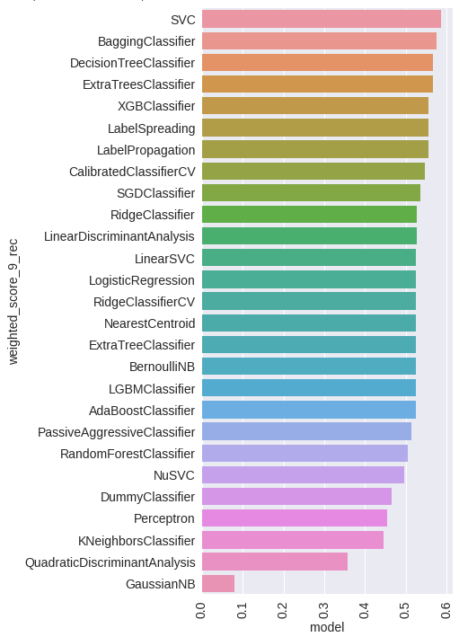
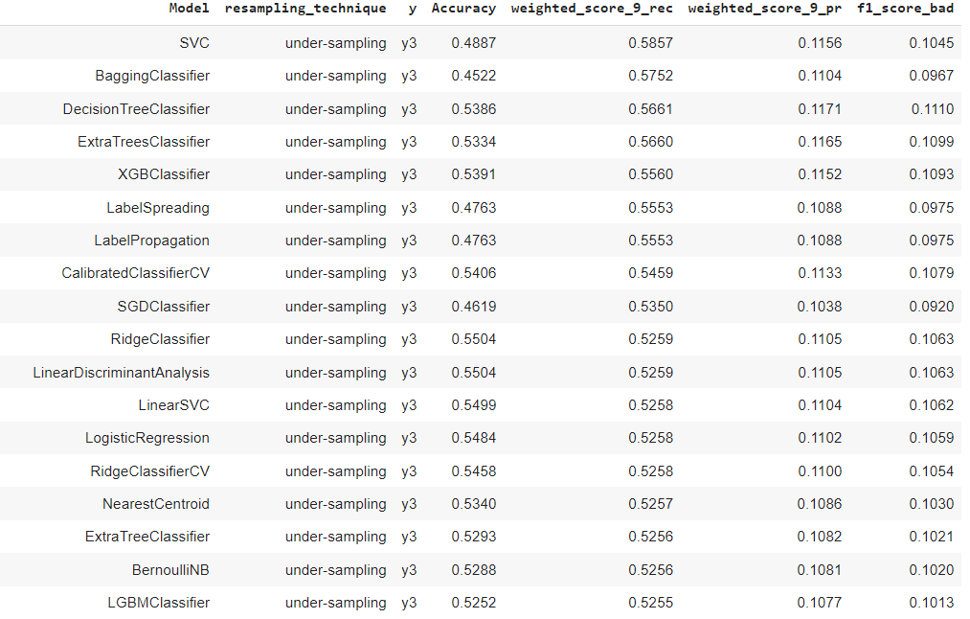
Auto ML - sample

Slide 23
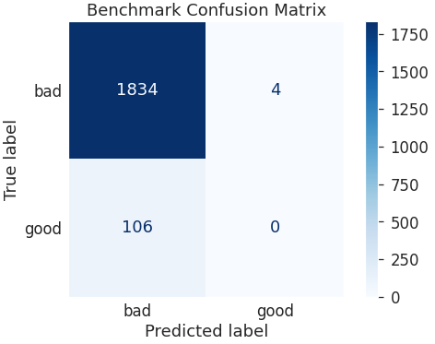
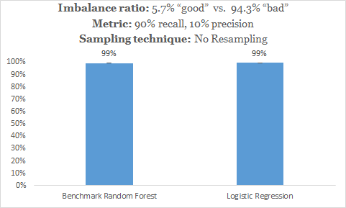
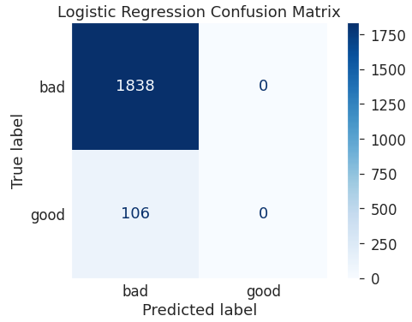
Comparing best model to baseline Y1

Slide 24
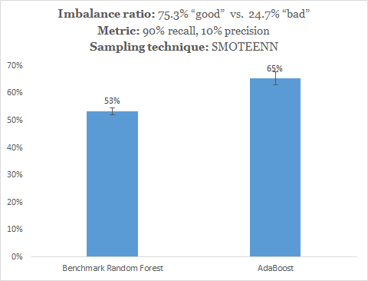
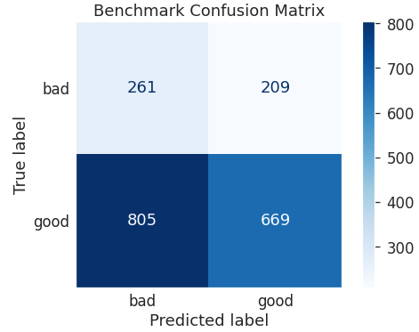
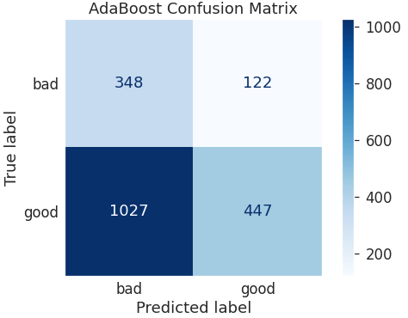
Comparing best model to baseline Y2
Nominal increase of 12%, x 1.22

Slide 25
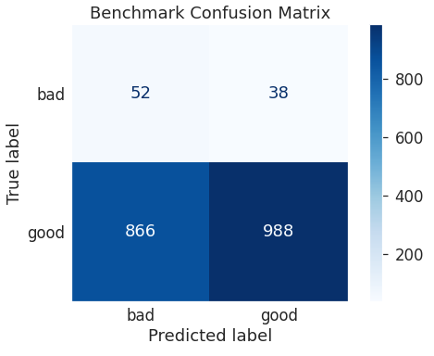
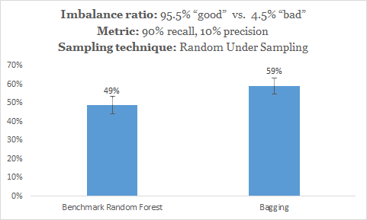
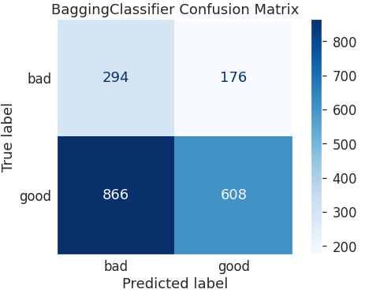
Comparing best model to baseline Y3
Nominal increase of 10%, x1.2

Slide 26
Conclusion and discussion
Use of resampling techniques improved our models metrics tremendously
The many models we ran presented a trade-off between recall and precision, you had to choose what to maximize
Trade-off between a mean and standard deviation in cross validation

Slide 27
Conclusion and discussion
The results for Y3 - Y6 were similar
Bigger imbalance problem meant generally less robust results
Using class weights to handle imbalance did not work
Different Y’s lead to different resampling technique and different optimal models

Slide 28
Key take-offs
We’ve used some new packages for different parts of our work:
Feature engine - used for feature engineering and pipelines
Lazy_predict - used to find the best models using auto ml
Imlearn - handling imbalance data
Resampling techniques helped improving our results, for example for y2 and improvement of overall 47% (6.5% vs 53%)
The data featured a trade off between precision and recall
Our final results did not feature one solution but a collection of solutions this was because we did not have a target label and just like in real life we present a space of different plausible solutions

